Slide 1
What is a professional body?
‘a non-profit organisation seeking to further a particular profession, the interests of the individuals engaged in that profession and the public interest’
Notes:
FIRSTLY, WHAT IS A PROFESSIONAL BODY?
- There’s many different professional bodies, such as the Association of Chartered Certified Accountants (ACCA), the Medical Royal Colleges, Institute of Fundraising and British Horse Society!
- The RSB supports the biosciences, and your future within it.

Slide 2
Welcome to the Royal Society of Biology
Notes:
WELCOME TO THE ROYAL SOCIETY OF BIOLOGY

Slide 3
Our Individual Members include: Our Organisational Members are other life sciences membership organisations and companies. They also support us to be the unifying voice of biology.
Nobel Laureates.
Students at all levels.
Life sciences professionals in academia, industry, education and policy.
Anyone else with an interest in biology.
Notes:
OUR MEMBERSHIP
We have 18,400 Individual Members (people) and 100 Organisational Members across the country… and world!

Slide 4
How can we support you?
Notes:
HOW CAN WE SUPPORT YOU?

Slide 5
YOU
Strengthen your CV
Grants
Network
Discover
Life after your degree
Notes:
AS A MEMBER, THESE ARE THE 5 WAYS YOU CAN ENGAGE WITH THE RSB

Slide 6
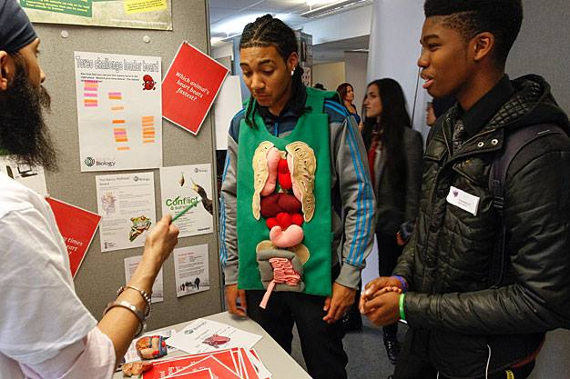
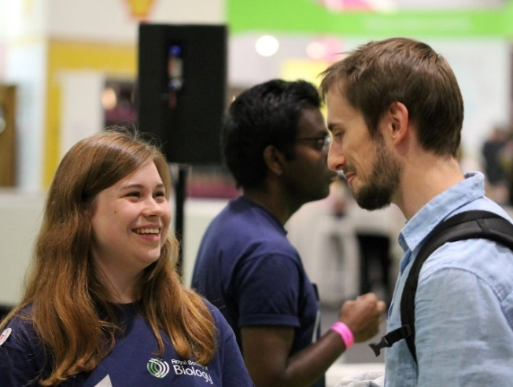
Strengthen your CV
Competitions and Awards
Top student award
Photography Competition
Volunteer in public engagement
Science Festivals, Big Biology Days, Regional Branch Events
outreach@rsb.org.uk
Notes:
ENTER A COMPETITION OR APPLY FOR AN AWARD
You may win the top student award if you graduate top of your class
Last year’s winner of the photography competition won £500 on the theme ‘The Hidden World’
VOLUNTEER IN PUBLIC ENGAGEMENT
Volunteer with the Society at a range of science fairs and festivals round the country, contact Amanda to express your interest.
Biology Week showcases the important and amazing world of the biosciences, getting everyone from children to professional biologists involved in fun and interesting life science activities – get involved creating or setting up an event! See the website for ideas.

Slide 7
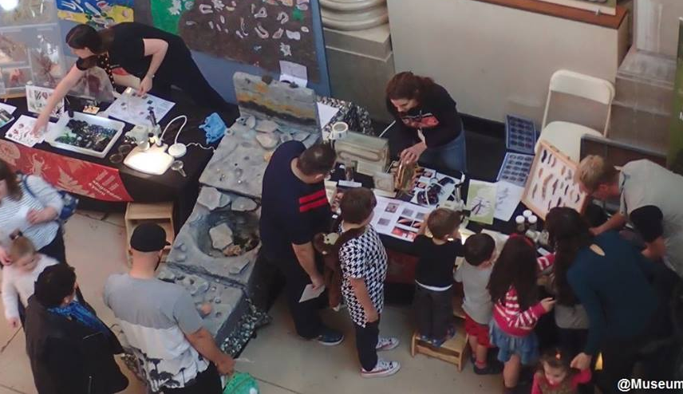
Grants
Travel grant
Outreach and engagement grant
£500 grant for overseas travel in connection with biological study, teaching or research for those who would otherwise be unlikely to have it.
Between £50 - £500 to help members run an event or activity in their region that engages members and the local community with biology
Notes:
TRAVEL GRANTs
£500 grant for overseas travel in connection with biological study, teaching or research for those who would otherwise be unlikely to have it. If you want to do a work placement, or visit a conference, do a apply to the RSB for this money to support you.
OUTREACH AND ENGAGEMENT GRANT SCHEME
If you have an idea for an event and are looking for some additional funds to help make it a success, you can apply for either a small grant of £50 - £200 or a full grant of £201 - £500.

Slide 8
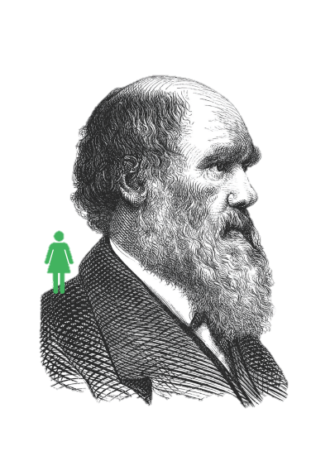
Network
Join your professional network
Members include your lecturers, as well as your future colleagues and employers.
They may hold your next work experience opportunity or help give you insight into working in academia, industry or education
Notes:
JOIN YOUR PROFESSIONAL NETWORK
Meeting other like-minded members, who are involved in academia, industry and education
Attend events, volunteer, get involved with your regional branch – you can develop invaluable skills, and meet people who could give you an insight into your future career.

Slide 9
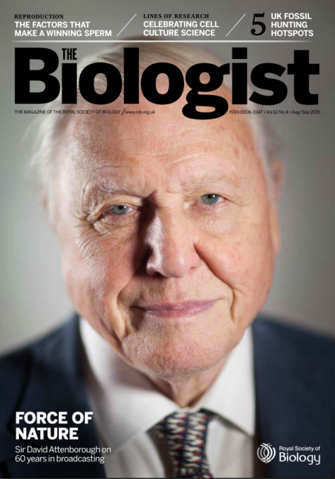
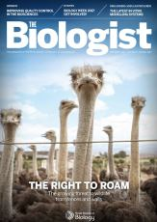
Discover
Newsletters
Science Policy
Membership
Education (schools)
Industry
BioNet (14-19 year olds)
Training & Personal Development
RSB Blog http://blog.rsb.org.uk
Notes:
TOPICAL NEWSLETTERS
Being a professional means staying on top of your field, so stay up to date with the latest science policy developments with our weekly science policy newsletter, a concise breakdown of what has happened from health and biomedicine to environment and ecology, from government and parliament to research funding policy.
Subscribe to our other monthly newsletters to receive news, events, the latest grants, competitions & awards.
THE BIOLOGIST MAGAZINE
Student affiliate members of the Society receive a free subscription to our bimonthly peer reviewed magazine The Biologist. Biology is brought to life through an impressive range of review articles, whilst topical pieces discuss science policy, new developments or controversial issues.
Like the New Scientist of Biology, looking at areas of the life sciences you may not have covered since school!
RSB BLOG
Read about all the fascinating areas of the life sciences in our blog, and if you’re doing something really interesting, you might be able to write for it too! Contact media@rsb.org.uk with your idea.

Slide 10
Discover Key Policy Areas
Biomedical Sciences
Environmental and Ecosystem Science
Agriculture and Plant Science
Science in Parliament
Research Environment and Practice
Equality and Diversity
Biology Education in the UK
Notes:
KEY POLICY AREAS
Find out what’s happening in all of these different areas of the life sciences

Slide 11
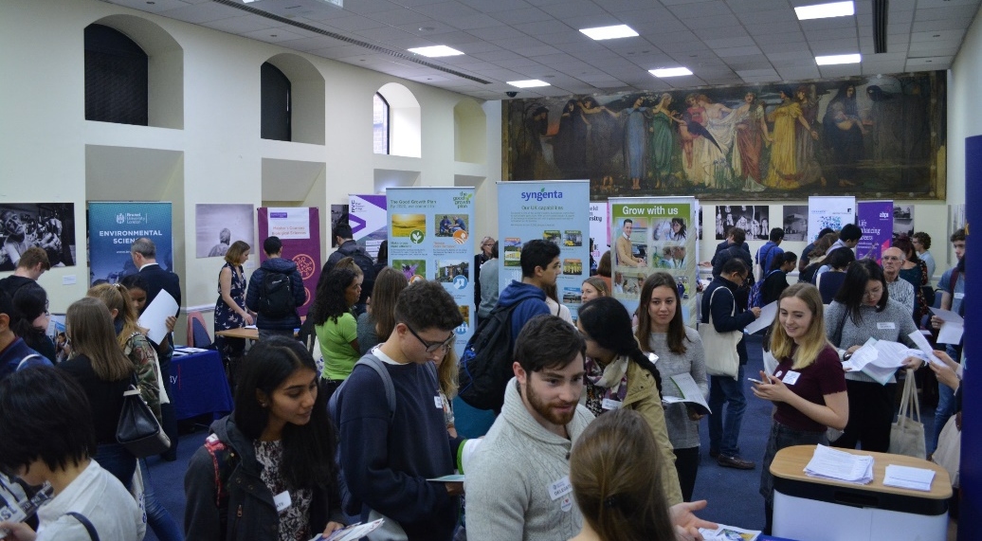
Life after your degree
jobs.rsb.org.uk
Online Careers resources www.rsb.org.uk/careers
Notes:
OUR JOBS BOARD
Check online for new job opportunities
Use our ONLINE CAREERS RESOURCES for advice on what to do next
ANNUAL BIOSCIENCE CAREERS DAY
Hear experts give top tips on exciting careers available to you with a biological sciences degree
Book a mock interview to sharpen your technique for future employers
Network with biology professionals and other students from across the UK
Watch science communicators live on stage & meet them afterwards
Meet representatives from a variety of top organisations in our exhibition and ask them informal questions over lunch

Slide 12
Join as a student affiliate for just £15 a year!
Notes:
JOIN AS A STUDENT AFFILIATE FOR JUST £15 A YEAR
Fill in the form and hand back to me,
{you can download and print these forms here www.rsb.org.uk/toolkit to hand out to the students or request a quick-join link at toolkit@rsb.org.uk}

Slide 13
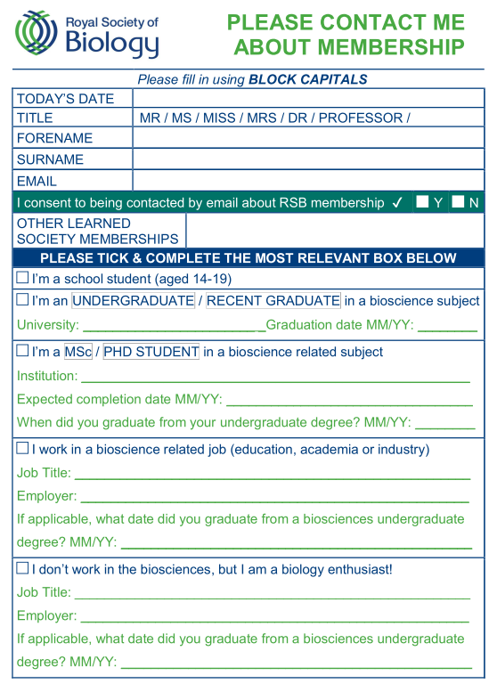
Interested?
Fill in the form
Hand back to me
The RSB will contact you with further information
Notes:
IF YOU’RE INTERESTED, PLEASE FILL OUT THIS FORM AND HAND BACK TO ONE OF US.
The RSB will email you, asking to complete your application online.

Slide 14
Join your Professional Association
Support your career
Become a member of the Royal Society of Biology
Notes:
SO, PLEASE DO JOIN YOUR PROFESSIONAL ASSOCIATION, SUPPORT YOUR CAREER AND BECOME A MEMBER OF THE ROYAL SOCIETY OF BIOLOGY
{insert your email address}

