Slide 1
The Royal Society of Biology and you
{insert name and grade}
Accurate as of October 2016
Notes:
OPENING
{insert name and grade}

Slide 2
Who are we?
What do we do?
How can we support you?
Notes:
INTRODUCTION
“This talk will help you find out:…”

Slide 3
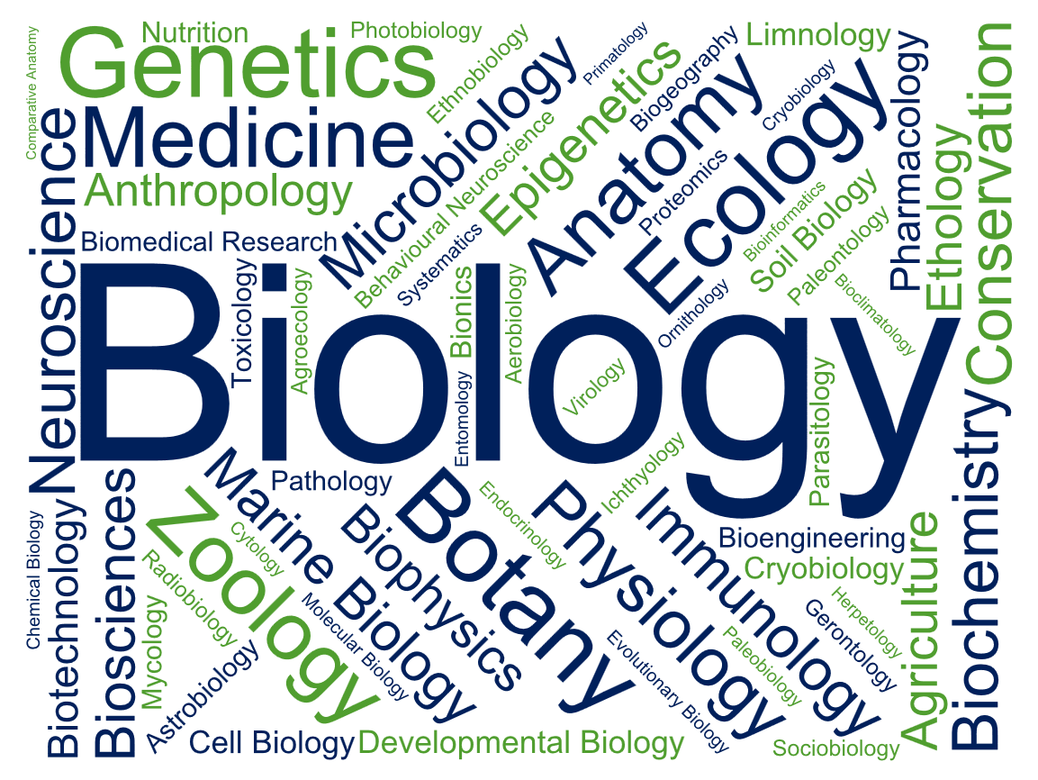
Notes:
AM I ELIGIBLE TO BECOME A MEMBER?
I am often asked, “If I don’t have the word ‘biologist’ in my title, does it mean I can’t become a member of the RSB?”
Up here are the different disciplines we promote, and our members work in - all of them are united by a core appreciation and understanding of biology, but the applications look very different!
So if any words there relate to what you do, or what you’re interested in, then you’re absolutely welcome to become a member of the Royal Society of Biology

Slide 4
1950 – 2009
2009 – 2015
2015
2002 – 2009
Notes:
OUR HISTORY
Some of you may have known the Institute of Biology? They’re one of the parent organisations that became what is now known today as the Royal Society of Biology
Chemistry had the Royal Society of Chemistry, Physics had the Institute of Physics, but for the Biological Sciences, there were about 100 membership bodies.
The government and policy making organisations wanted one key organisation to convene with, so the Institute of Biology merged with the Biosciences Federation to form the Society of Biology in 2009
In 2015, we were granted our Royal title, which is a tremendous accolade for the work we are doing to fulfil our charitable initiatives and support the life sciences in the UK.

Slide 5
Our vision is of a world that understands the true value of biology and how it can contribute to improving life for all Our mission is to;
Be the unifying voice for biology
Facilitate the promotion of new discoveries in biological science for national and international benefit
Engage the wider public with our work
Notes:
WHAT WE STAND FOR
Our vision and mission

Slide 6
Our Individual Members include: Our Organisational Members – other life sciences membership organisations and companies – also support us to be the unifying voice of biology.
Practising scientists and technicians
Students at all levels.
Life sciences professionals in academia, industry, education and policy.
Non-professionals with an interest in biology.
Notes:
OUR MEMBERSHIP
We have over 18,400 Individual Members and 100 Organisational Members across the country… and world!

Slide 7
Meet a member
Insert Picture
{Name} {Job Title} {Institution}
{Joined in –year–}
Notes:
INTRODUCE YOURSELF IN FULL
This is an opportunity to talk more about yourself and what your involvement is with the Society
You can take a few minutes to explain:
When you became a member
Why you think the society is important
What you gain most from your membership

Slide 8
RSB Key Activities
Advise government and influence policy
Advance education and professional development
Engage and encourage public interest in the life sciences
Support people working in the life sciences
Notes:
FOUR KEY AREAS THE ROYAL SOCIETY OF BIOLOGY WORKS IN

Slide 9
Member
Keep informed
Enhance your career
Engage the Public
Network
Support the future of Biology
Notes:
AS A MEMBER, THESE ARE THE 5 WAYS YOU CAN ENGAGE WITH THE RSB

Slide 10
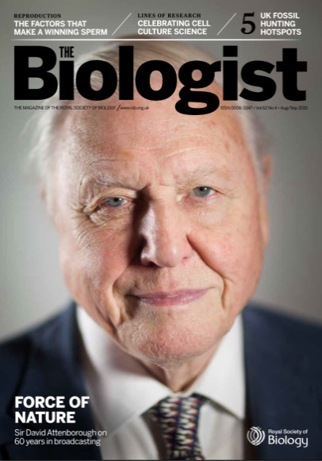
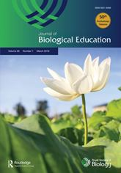
Keep informed
Subscribe to topical
E-Newsletters
The Biologist bi-monthly magazine
Journal of Biological Education
Science Policy
Higher Education
Membership
Training & Personal Development
Industry
Education (schools)
BioNet (14-19 yo’s)
Notes:
TOPICAL NEWSLETTERS
Stay up to date with the latest science policy developments with our weekly science policy newsletter, a concise breakdown on what has happened from health and biomedicine to environment and ecology, from government and parliament to research funding policy.
Subscribe to our other monthly newsletters to receive news, events, the latest grants, competitions & awards.
BI-MONTHLY THE BIOLOGIST
All members of the Society receive a free subscription to our bimonthly peer reviewed magazine The Biologist. Biology is brought to life through an impressive range of review articles, whilst topical pieces discuss science policy, new developments or controversial issues.
Like the New Scientist of Biology, looking at areas of the life sciences you may not have covered since school!
JOURNAL OF BIOLOGICAL EDUCATION
The Journal of Biological Education is an international journal that publishes the latest research into the teaching, learning and assessment of biology.
Members receive a reduced fee subscription price.

Slide 11
Enhance your Career
Post-nominal Letters
Professional Registers
AMRSB
MRSB
FRSB
RSciTech
RSci
CSci
CSciTeach
CBiol
QP
CPD Training
Travel Grants
50% discount for members and online platform now available
https://learn.rsb.org.uk/
£500 grant for overseas travel in connection with biological study, teaching or research
Notes:
POST-NOMINAL LETTERS
Boost your professional recognition by using our post-nominal letters
PROFESSIONAL REGISTERS
These recognise the range of knowledge, experience and professionalism that are sought after by employers and demanded by the public – to find out more visit www.rsb.org.uk/registers
We run our own professional register Chartered Biologist, the Science Council Registers for Registered and Chartered Scientist, and other registers such as Qualified Person.
CPD TRAINING
Continue your Professional Development as a member and save 50% off our training courses.
From Persuasive Scientific Report Writing and Commercial Awareness for Life Scientists, to introduction to Science Communication – we want you to expand your expertise.
Courses available online
TRAVEL GRANTs
£500 grant for overseas travel in connection with biological study, teaching or research for those who would otherwise be unlikely to have it. There are 2 categories.
Student affiliate and AMRSB members.
MRSB members in the early stages of their research careers (0-10 years in paid employment) only.

Slide 12
Network
Groups and Committee’s events
Join your Regional Branch
Attend an RSB event
Last year, the RSB organised more than 400 events across the UK
Attend events like:
RSB AGM and Charter Lecture
Fellows’ lunches
Awards ceremonies
Policy seminars
There are 19 active regional branches
{insert name of branch}
Notes:
ATTEND AN RSB EVENT
Last year, the RSB organised more than 400 events
Events include fundraisers, in previous years we’ve welcomed Sir David Attenborough and Sir Alec Jeffreys for an evening exploring their careers and discoveries.
Other events include our AGM, Charter Lectures and Fellow’s lunches to name but a few.
GROUPS AND COMMITTEE’S EVENTS
The RSB has several Special Interest Groups that run their own interdiscplinary events that you are welcome to attend, such as:
UK Plant Sciences Federation
Natural Capital Initiative
Heads of University Biosciences
JOIN YOUR REGIONAL BRANCH
There are 19 regional branches across the UK, with one in Hong Kong and Australia. {you can find your regional branch here: www.rsb.org.uk/regional-activity)
Once you become an elected member, you can get involved with your regional branch to help create events or projects engaging biologists and the public.

Slide 13
{insert name} Regional Branch
Members from academia and industry, contact xxx@rsb.org.uk
Upcoming events
xxx
Recent events
xxx
Notes:
YOUR REGIONAL BRANCH
{Find your regional branch here: https://www.rsb.org.uk/regional-activity and input a contact email, upcoming events, recent events and some pictures}

Slide 14
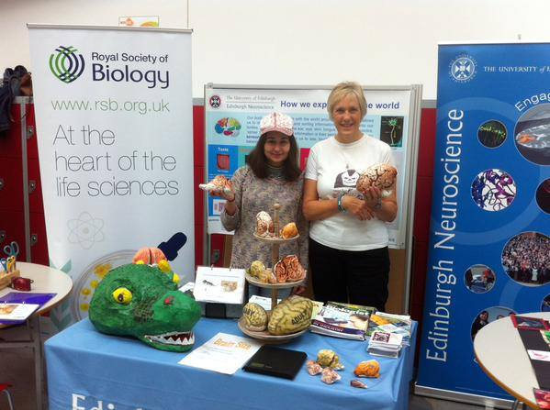
Engage the Public
Regional Grant Scheme
Communicate your science!
Small Grants £50 - £200
Full Grants £201 - £500
Hands on Science
Volunteer with the RSB or your Regional Branch
Biology Week showcases the wonderful world of biology
Activities at UK Science Festivals
Awards & Competitions
SciComm training
Notes:
REGIONAL GRANT SCHEME
If you have an idea for an event for Biology Week 2018, or a local science engagement event and are looking for some additional funds to help make it a success, you can apply for either a small grant of £50 - £200 or a full grant of £201 - £500.
HANDS ON SCIENCE
Biology Week showcases the important and amazing world of the biosciences, getting everyone from children to professional biologists involved in fun and interesting life science activities.
We run a range of awards and competitions for our members and biology enthusiasts, such as the Science Communication Awards, Photography Competition, HE Teacher of the Year Award and the British Biology Olympiad.
VOLUNTEER
Volunteer with the Society at a range of science fairs and festivals round the country

Slide 15
Support the Future
Policy
Parliamentary & Policy Events
Since 2009, the RSB have submitted >100 policy consultation responses
Parliamentary Links Day
Voice of the Future
Policy Lunchbox
Undergraduate Membership
Education
£15/year
Money off books & Apply for Grants
Careers Resources & Conference
Strengthen CV
Resources
Special Interest Groups and Committees
Competitions and Awards
Degree Accreditation
Notes:
POLICY
The RSB wish to provide a balanced response, reflecting the views of the biosciences profession:
We do this in consultation with our Member Organisations and Individual Members
We perform both proactive and reactive policy work
PARLIAMENTARY & POLICY EVENTS
Links Day is the largest science event on the annual Parliamentary events calendar, and is organised by the RSB on behalf of the science and technology community, bringing together scientists, learned societies and Members of Parliament.
Voice of the Future is an annual event that brings young scientists and engineers together to quiz key political figures at the Houses of Parliament about the science policy issues that matter to them.
Throughout the year, a collaboration of several societies run a series of Policy Lunchbox lunchtime events to bring together guest speakers with those who work in science policy.
UNDERGRADUATE MEMBERSHIP
For £15/year, undergraduate membership includes:
The Biologist & e-newsletters
Careers Conference & Resources
Money off books & apply for Grants
Strengthen your CV and join our network
EDUCATION
The RSB are committed to supporting and encouraging the study of biology at all levels:
We are contributing to curriculum development through the work of our curriculum committee, primary working group and student group.
We have developed resources to support teachers and students in primary, secondary and higher education.
Students have a chance to show their brilliance in biology whilst taking part in our competitions.
Teachers can gain recognition with awards for excellence in teaching at university, secondary and primary school level and by applying for the Chartered Science Teacher register.

Slide 16
RSB Key Activities
Advise government and influence policy
Advance education and professional development
Engage and encourage public interest in the life sciences
Support people working in the life sciences
Notes:
TO SUMMARISE, THESE ARE THE FOUR KEY AREAS THE ROYAL SOCIETY OF BIOLOGY WORKS IN

Slide 17
YOU
Keep informed
Enhance your career
Engage the Public
Network
Support the future of Biology
Notes:
AND THIS IS HOW YOU CAN GET INVOLVED WITH US AS A MEMBER

Slide 18
Tax-deductible & check if you’re eligible for a discount
Student Affiliate
Student of degree with at least 50% Biology in final two years.
£15pa
AMRSB
Graduate in bioscience subject with at least 3 years’ postgrad experience. Also a CPD route
£90-£132 pa
MRSB
£79 pa
FRSB
Prominent contribution to advancement of biological sciences and at least five years’ experience in a position of senior responsibility
£186 pa
Awarded a degree containing at least 50% Biology in final two years. Also a CPD route
Affiliate
Anyone with an interest in the life sciences
Starts at £67
Notes:
THESE ARE THE DIFFERENT GRADES OF MEMBERSHIP
Affiliate: Anyone with an interest in the life sciences
Student Affiliate: HEI student studying a biology-related subject
Associate (AMRSB): Awarded a degree containing at least 50% biology in the final two years of study. Also a CPD route
Member (MRSB): Graduate in a bioscience subject with at least three years’ postgrad experience. Also a CPD route
Fellowship (FRSB): Prominent contribution to the advancement of the biological sciences, at least five years’ experience in a position of senior responsibility
You can use the Membership benefits spreadsheet for more indepth information
DISCOUNTS are available if you are a Recent Graduate <2 years, Masters or Phd Student, in Unpaid Employment, Retired or on a Career Break, or a member of one of our Member Organisations.

Slide 19
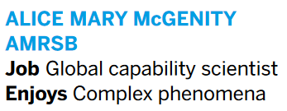
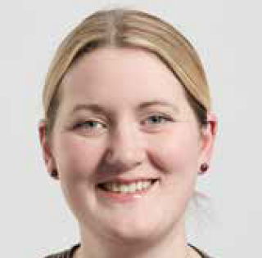
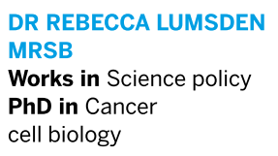
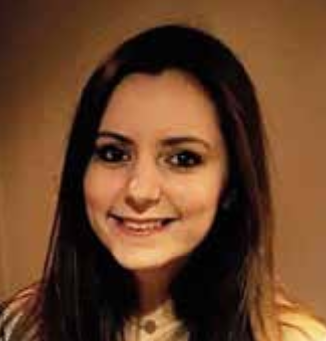
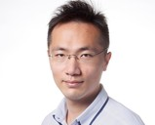
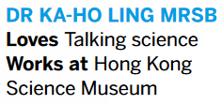
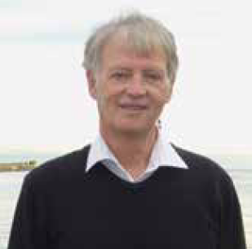
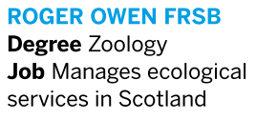
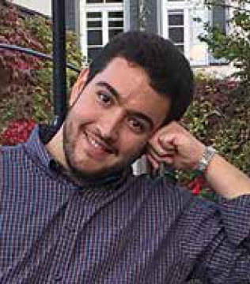
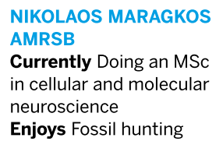
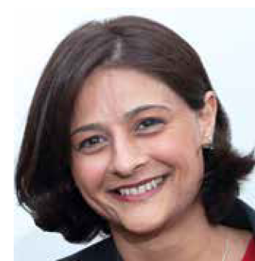
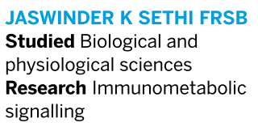
Our members
Notes:
OUR MEMBERS
- Range from interested members of the public, to Nobel Laureates, PhDs to PIs, Teachers and students alike.

Slide 20
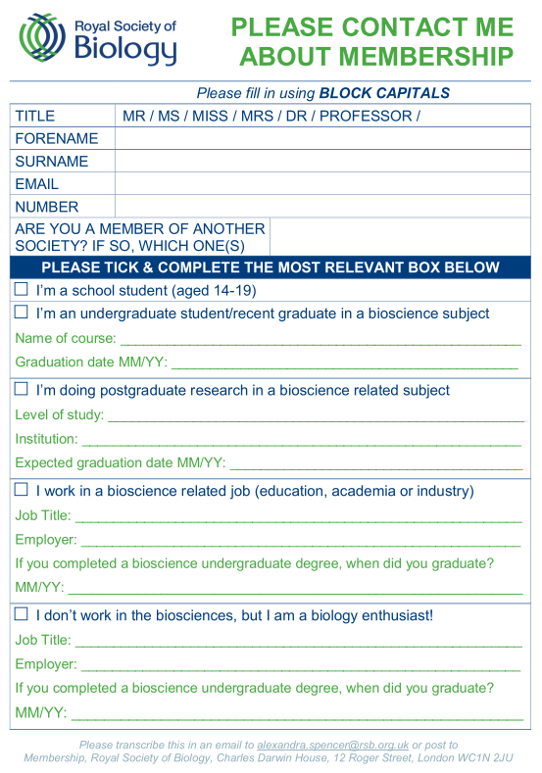
Interested?
Fill in the form
Hand back to me
The RSB will contact you with further information
Notes:
IF YOU’RE INTERESTED, PLEASE FILL OUT THIS FORM AND HAND BACK TO ONE OF US.
The RSB will email you, asking to complete your application online.
Save £15 by completing this form, as RSB will remove the extra administration fee.

Slide 21
Join your Professional Association
Support the Life Sciences
Become a member of the Royal Society of Biology
{insert your email address}
Notes:
SO, PLEASE DO JOIN YOUR PROFESSIONAL ASSOCIATION, SUPPORT THE LIFE SCIENCES AND BECOME A MEMBER OF THE ROYAL SOCIETY OF BIOLOGY
{insert your email address}

Slide 22
Thank you
Thank you to our strategic partner group
Notes:
THANK YOU

