Slide 1
HOW TO USE THIS PRESENTATION
This Presentation should be used alongside the Biochemistry Careers Lesson Plan.
Clickable URL links appear as www.domain.com
References to specific careers resources appear in green boxes
Activities appear in blue boxes
You can find out more about the Royal Society of Biology at www.rsb.org.uk
Notes:
About this resource

Slide 2
Overview
Mind map
Careers: resources and activities
Further support for students
Biochemistry: The Molecules of Life
Notes:
Overview of resource

Slide 3
Additional teaching resources
Practical Biology
Tried and tested practical activities that explain biological concepts:
www.nuffieldfoundation.org/practical-biology/bio-molecules
SciberMonkey
Database of learning resources that have been quality assured by science teachers:
www.scibermonkey.org
Notes:
About the resources:
Practical Biology
Tried and tested practical activities that explain biological concepts.
Includes CLEAPSS safety advice, student sheets, technician guidance notes and equipment lists.
Resource developed by the Nuffield Foundation and the Royal Society of Biology in association with CLEAPSS.
SciberMonkey
Database of dynamic learning resources for science subjects.
Content quality assured by science teachers.
Resource originally created by the Biochemical Society, an currently run by the Royal Society of Biology.

Slide 4
Additional teaching resources
Essays in Biochemistry
Overviews of key areas of biochemistry for post-16 students, teachers and undergraduates:
www.biochemistry.org/education/teachers/biochemistrybooklets
SciberBrain
Collection of resources looking at ethical issues in science that encourage class discussions:
www.sciberbrain.org
Notes:
About the resources:
Essays in Biochemistry
Informative and up-to-date overviews of key areas in biochemistry.
Explores enzymes and cell membrane organisation.
SciberBrain
Resources include presentations, videos and quizzes, selected by teachers and scientists.
Stimulates group discussions about controversial aspects of science, such as genetic engineering and clinical trials.

Slide 5
Further support for teachers
STEM Insight
Programme offers staff in schools and colleges a unique chance to experience STEM-related work in industrial or university settings:
www.stem.org.uk/stem-insight
STEM Ambassadors
STEM professionals and enthusiasts who visit schools to promote STEM subjects, inspire students and raise awareness of careers:
www.stem.org.uk/stem-ambassadors
Notes:
Further support for teachers

Slide 6
We would like to thank the Biochemical Society for their generous support for this project, which has allowed us to produce this Initial Teacher Education resource.
This is part of a collection of new careers resources which help teachers highlight to their students future careers and the opportunities of studying bioscience subjects beyond school, such as biochemistry.
Notes:
Biochemistry Careers Lesson

Slide 7
Biochemistry Careers www.rsb.org.uk/careers
Notes:
Biochemistry Careers Lesson

Slide 8
Learning outcomes
By the end of this lesson, you will:
Have explored a variety of biochemistry careers
Have understood how to access careers information provided by the Royal Society of Biology and the Biochemical Society
Notes:
Learning outcomes

Slide 9
Mind map
What is a biochemist?
What biochemistry careers can you think of?
What might you study?
What skills might you develop?
Notes:
Activity 1: Mind map

Slide 10
Biochemists study the chemical processes that happen in living organisms.
Job titles you might see for biochemists:
Biotechnologist
Cosmetic scientist
Food technologist
Government adviser
Clinical biochemist
Lawyer
Pharmacologist
Publisher
University researcher
Sales representative
Notes:
Activity 1: Mind map
Example answers (“What biochemistry careers can you think of?”).
Adapted from:
www.biochemistry.org/Portals/0/Education/Docs/Biochem_Booklet_web%20NEW.pdf
www.biochemistry.org/Portals/0/Education/Docs/Industry%20resource%20Web%20PDF.pdf

Slide 11
What biochemists might have studied:
Biochemistry
Biomedical science
Biotechnology
Cell biology
Genetics
Immunology
Molecular biology
Neurobiology
Pathology
Pharmacology
Notes:
Activity 1: Mind map
Example answers (“What might you study?”).
Adapted from:
www.biochemistry.org/Portals/0/Education/Docs/Biochemistry%20Prospectus%202016.pdf

Slide 12
What skills biochemists might have developed:
Analytical skills
Creative thinking
Experience of writing reports
IT skills
Leadership
Numeracy and maths
Observational skills
Planning
Presentation skills
Problem solving
Scientific techniques
Self-motivation
Team working
Time management
Notes:
Activity 1: Mind map
Example answers (“What skills might you develop?”).
Adapted from:
www.biochemistry.org/Portals/0/Education/Docs/Biochem_Booklet_web%20NEW.pdf
www.biochemistry.org/Portals/0/Education/Docs/Industry%20resource%20Web%20PDF.pdf
www.biochemistry.org/LinkClick.aspx?fileticket=LgzuE6NI84U%3d&tabid=791
www.biochemistry.org/Education/Schoolsandcolleges/Biochemistrycourses.aspx

Slide 13
Careers resource
Make a Difference posters and website highlight career paths biologists can take:
www.rsb.org.uk/make-a-difference
Notes:
Careers resource
About the resource:
Make a Difference
Highlights career paths biologists might take, including workplaces, job titles and courses.
Resource was jointly developed by the Biochemical Society, British Ecological Society, British Pharmacological Society, Microbiology Society, Society for Experimental Biology, Royal Society of Biology and The Physiological Society.

Slide 14
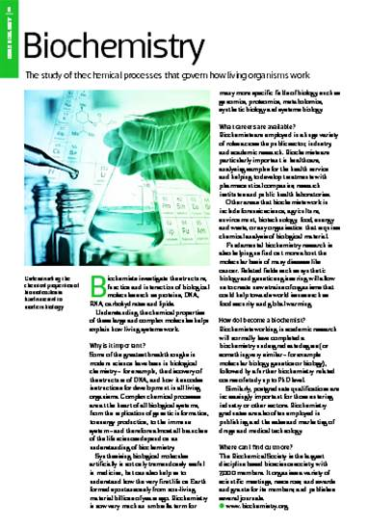
Careers resource
Spotlight on the Life Sciences is a guide to biology careers and includes interviews:
www.rsb.org.uk/spotlight
Notes:
Careers resource
About the resource:
Spotlight on the Life Sciences
Guide to biology careers.
Features a collection of articles and interviews from The Biologist magazine, and covers a broad range of bioscience fields.

Slide 15
Career Profile Card/Pitch
Make your own career profile card or create a 30-second pitch for a biochemistry career using the Make a Difference posters/website and Spotlight booklet.
Notes:
Activity 2: Career Profile Card/Pitch
(Delete career profile card/pitch as appropriate)

Slide 16
Careers resource
Becoming a Biologist includes information on:
Biology degrees and alternatives
Applying to university
Getting work experience
www.rsb.org.uk/becoming-a-biologist
Notes:
Careers resource
About the resource:
Becoming a Biologist
Booklet contains information on different types of biological degree and their alternatives, qualifications students will need to study them, skills gained from biological studies, and advice about careers students can do after graduating.

Slide 17
Careers resource
Biochemistry: the career guide includes information on:
Biochemistry courses and their content
Careers options
Biochemist careers profiles
www.biochemistry.org/Portals/0/Education/Docs/Biochem_Booklet_web%20NEW.pdf
Notes:
Careers resource
About the resource:
Biochemistry: the career guide
Booklet contains information on biochemistry further education courses, what students might study at university, the transferable skills they could gain, careers options and also profiles of biochemists.

Slide 18
Bingo
Play Biochemist Bingo.
Answers can be found by reading the careers booklets.
Notes:
Activity 3: Bingo

Slide 19
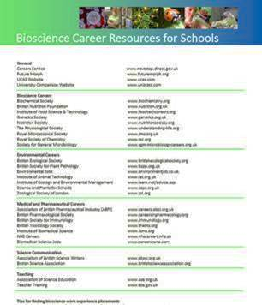
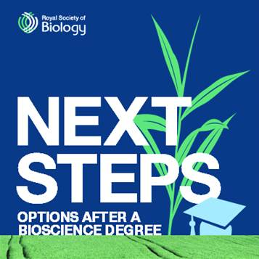
Further support from the Royal Society of Biology
Careers information and guidance resources all available online via:
www.rsb.org.uk/careers
Notes:
Further support for students

Slide 20
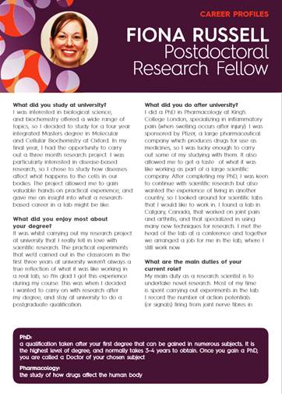
Further support from the Biochemical Society
Careers profiles of people working in a variety of biochemistry-related jobs:
www.biochemistry.org/Education/Schoolsandcolleges/Careerprofiles.aspx
Notes:
Further support for students
About the resource:
Career profiles
Profiles of individuals who have studied biochemistry and know in a variety of jobs.
Information on duties and responsibilities, skills used and career paths.

Slide 21
Further support from the Biochemical Society
BioPathways showcases short video interviews of people who have studied bioscience degrees:
www.youtube.com/user/BioPathways
Notes:
Further support for students
About the resource:
BioPathways
Seven short interviews featuring individuals, who have studied bioscience degrees, discussing their career paths and current work.
Project organised by Elizabeth Granger at the University of Manchester and funded by the Biochemistry Society’s Scientific Outreach Grant scheme.

Slide 22
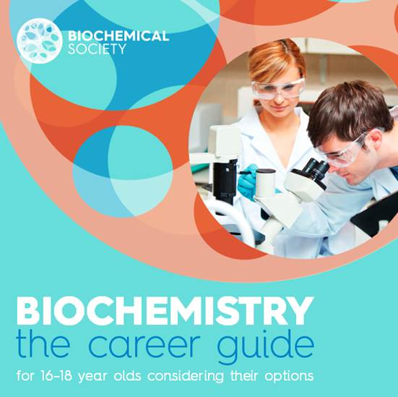
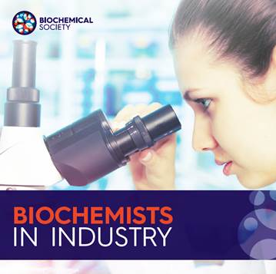
Further support from the Biochemical Society
Careers information and guidance resources all available online via:
www.biochemistry.org/education/schoolsandcolleges.aspx
Notes:
Further support for students

Slide 23
Biochemistry: The Molecules of Life
The free online course provides an introduction to biochemistry, including career opportunities:
www.futurelearn.com/courses/biochemistry
Notes:
Biochemistry: The Molecules of Life
About the resource:
MOOC (Massive Open Online Course) provides an introduction to biochemistry, exploring its impact on bioenergy and health, and the diversity of career paths available.
Duration 3 weeks, 3 hours per week
Created jointly by University of East Anglia and Biochemical Society.

Slide 24
Biochemistry: The Molecules of Life
Notes:
Activity 4: Discussion

Slide 25
Biochemistry: The Molecules of Life
What is Melissa’s job?
How did she become a biochemist?
Why does she think biochemistry is important and useful?
Notes:
Activity 4: Discussion

