Slide 1
The Nancy Rothwell Award 2019

Slide 2
Key information
Natural specimen drawing competition
Age groups: 7-11, 12-14 and 15-18
Highly commended and winning entries will be presented with certificates, and be invited to an experience day at the Royal Veterinary College where they will get to meet the artist in residence and receive a guided tour of the anatomy museum and dissection rooms
Deadline for entries: 30th July 2019
More information: www.rsb.org.uk/nancy-rothwell-award

Slide 3
Learning Objectives
You will:
Learn why drawings are important for science
Know how vets use drawings
Draw a real object yourself!
Find out about the artist at the Royal Veterinary College

Slide 4
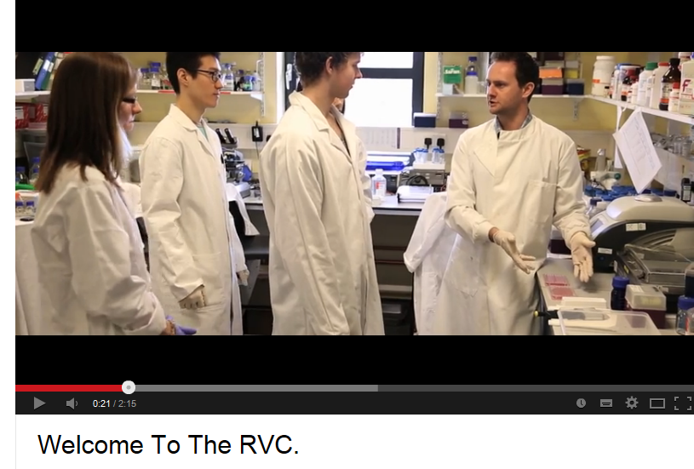
Introduction
What is the Royal Veterinary College?
Click the image to see a film introduction
Look out for our museum!

Slide 5
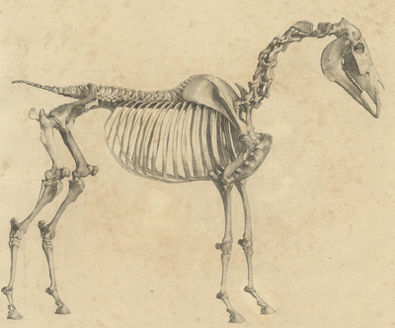
Science drawings
You are about to look at ANATOMY drawings.
What does anatomy mean?
This is by a famous artist called George Stubbs (1724- 1806).
Bonus activity: look up some of his other work…
This resource is shared by The Royal Veterinary College under a Creative Commons Attribution-NonCommercial-NoDerivs 3 license.

Slide 6
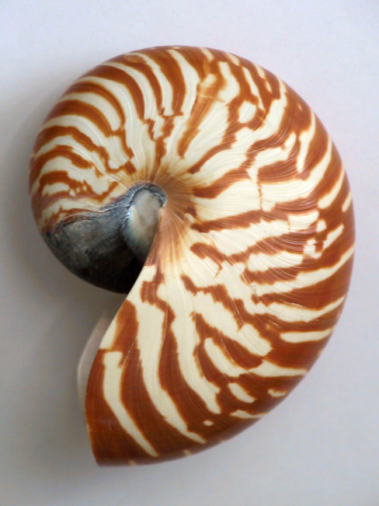
Specimens
A specimen means a preserved natural object
Although they are often parts of animals or plants which have died of natural causes, they have been kept so that we can learn from them.
Sometimes people collect natural objects such as shells or fossils.
Have you ever collected any natural objects?
Have you ever been to any museums with a collection of specimens?

Slide 7
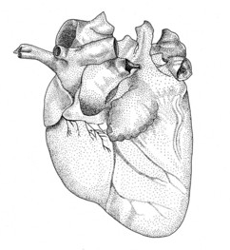
Anatomy
Anatomy isn’t just about drawing bones.
What is this organ?
Which animal do you think it is from?
This resource is shared by The Royal Veterinary College under a Creative Commons Attribution-NonCommercial-NoDerivs 3 license.
Why has the anatomist used shading on this drawing?

Slide 8
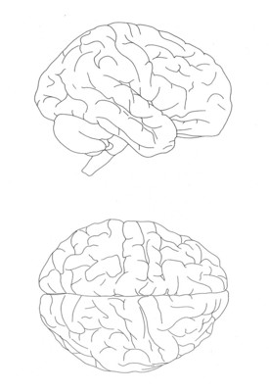
History of anatomy
Look up ‘The anatomy of the horse in the 15th century’
What do you notice?
The Ancient Egyptians and Greeks even studied anatomy!
Look up Galen and Vesalius if you are really keen to find out more about the history.
People have drawn specimens to understand them better for many years.
True or false? The famous scientists and artist Leonardo Da Vinci studied anatomy.
Find out!
This resource is shared by The Royal Veterinary College under a Creative Commons Attribution-NonCommercial-NoDerivs 3 license.

Slide 9
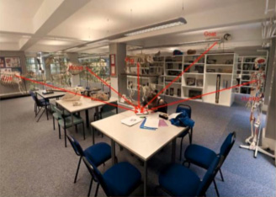
Vet students and anatomy
Studying the parts of the body helps vets know how to put animals back together if they have been injured!
Activity: draw a dog. You could use a whiteboard for this. Draw where you think the ribs, heart and skull are in the body.
The museum in the Royal Veterinary College in Camden, where students learn from real specimens, by drawing them, working out what each part is…and learning it!

Slide 10
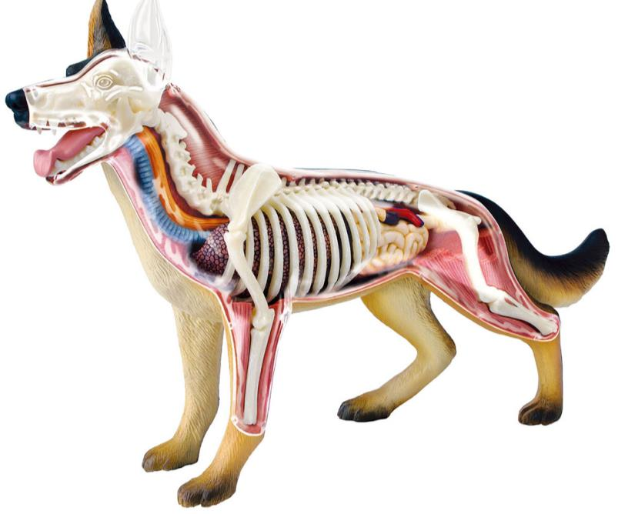
Animal anatomy
Were you right?
Which organs are the same as humans?
What is different?
The heart drawing you saw earlier is from a dog!
Drawing an object rather than taking a quick photo means you have to really think about it!

Slide 11
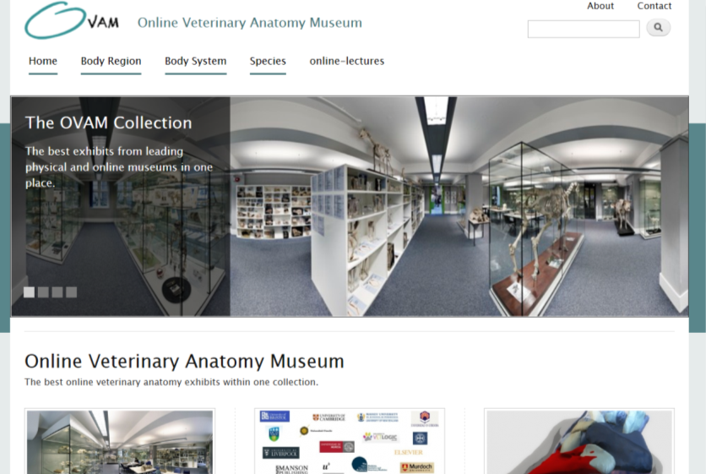
Online Veterinary Anatomy Museum
The Online Veterinary Anatomy Museum is an open access resource to let you look at virtual specimens.
Explore the museum highlights by clicking the image
Hear more about the project: https://www.youtube.com/watch?v=l4CjRLq6E1E

Slide 12
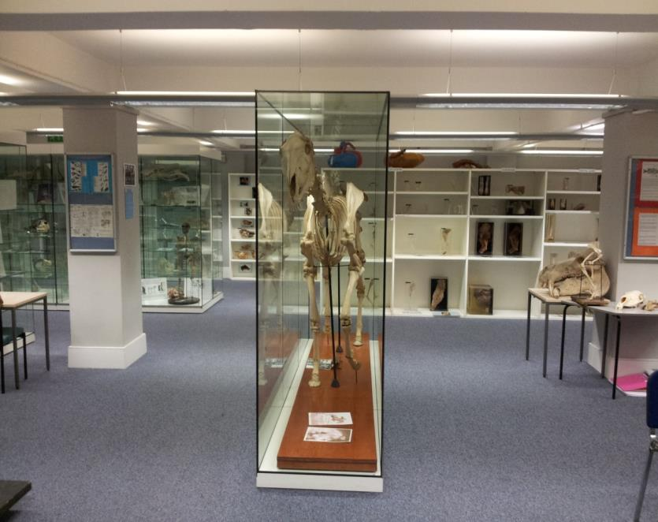
Animation
Animators sometimes use knowledge of anatomy when making cartoons or inventing new creatures.
The horse skeleton in the Royal Veterinary College shows Foxhunter, an Olympic prize winning showjumper in the 1950s.
It was used as the basis for a creature in Harry Potter. Can you guess which one?

Slide 13
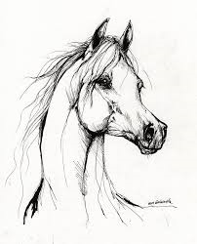
In artistic drawings, it is ok to have many lines, when you are sketching, to try to get a sense of emotion or movement for example.
Remember scientific drawing is all about accuracy and careful observation. It is great if it can also look beautiful too! However, the communication purpose is most important

Slide 14
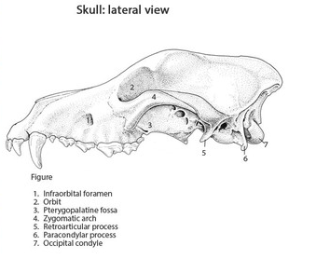
Anatomy illustrations are for teaching students or vets for example. They are very precise.
You might choose to label your final piece by researching the name of each part
This resource is shared by The Royal Veterinary College under a Creative Commons Attribution-NonCommercial-NoDerivs 3 license.

Slide 15
Which style do you prefer?

Slide 16
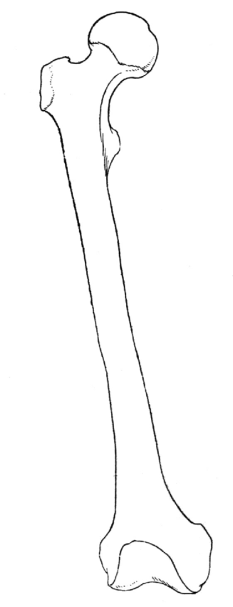
Your drawing
Include:
Title
Your first name
Your school
Your class
Choose a real specimen (natural object) to draw
What do you think it is from?
Think carefully about which view you will draw- what do you want to viewer to understand about the specimen?
Handle the object if you can.
Which parts are rough?
Which parts are smooth? Why, what is their function?
How will you show this in your drawing?

Slide 17
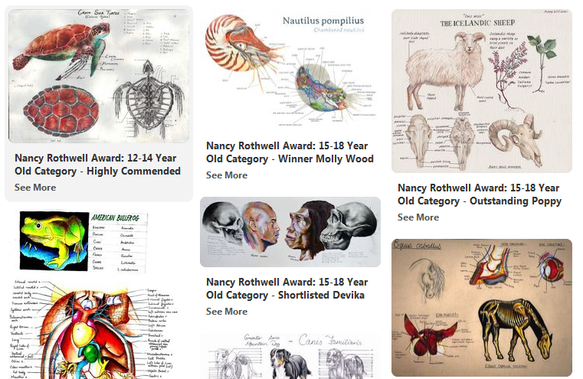
Inspiration
View the full 2018 shortlisted entries on Pinterest: https://www.rsb.org.uk/get-involved/rsb-awards/nancy-rothwell-award/nancy-rothwell-award-2018-shortlist

Slide 18
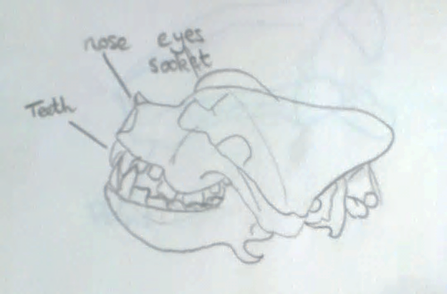
Final piece
Practice some different styles and materials – you could use different coloured paper, chalks, pastels, watercolour or oil paints even!
Visit a museum or borrow some natural objects and practice.
Make some sketches and then a final piece
Download an application form from: www.rsb.org.uk/nancy-rothwell-award
Submit artwork by Tuesday 30th July 2019.
Example drawn by a Y4 pupil from Wroxham School, Hertfordshire
Include:
Title
Your first name
Your school
Your class

