Slide 1
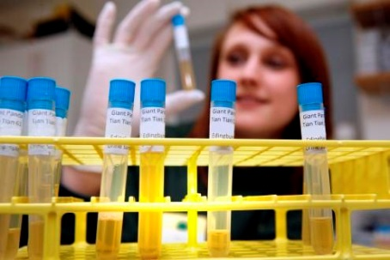
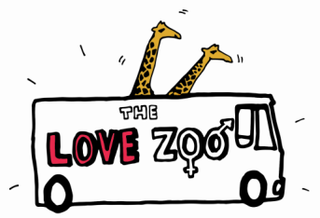
What
is
Endo
crinology?
Endocrinology is an area of science that explores special chemicals called hormones; these are produced inside the bodies of humans and other living things.
It has links with both biology and medicine.
What do endocrinologists do?
Endocrinologists investigate how hormones are made, stored and released by glands (special organs in the body).
They also find out how hormones affect the way the body works and how they affect behaviour in humans and other animals.
Endocrinologists measure levels of hormones in the blood, urine or other bodily fluids of the animal they are studying. This can help them find out if a health problem is because of a change in hormones.

Slide 2
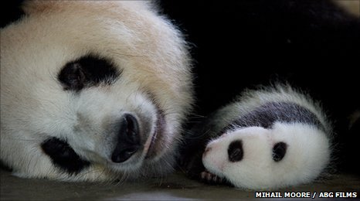
Endocrinologists are trying to help pandas have babies!
Pandas are one of the world’s most endangered species so it is important the ones left can reproduce.
Female pandas are only fertile for 24 to 36 hours once a year.
Pandas in captivity can’t get pregnant easily so zoo-keepers call in endocrinologists to help.
The endocrinologists test the female panda’s urine every day to look at her hormone levels.
The endocrinologists test the female panda’s urine every day to look at her hormone levels.

